Slide 1
Brainstorm and immaturity thinking
Fangji Chen

Slide 2
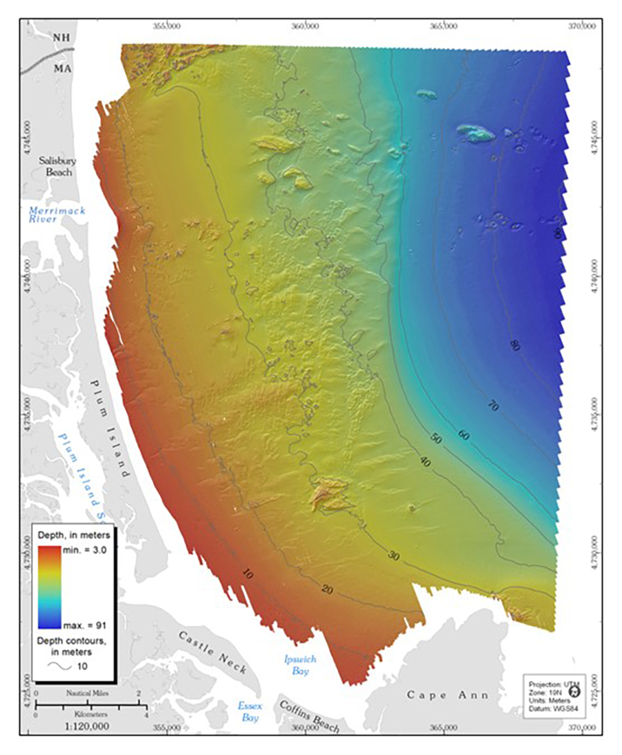
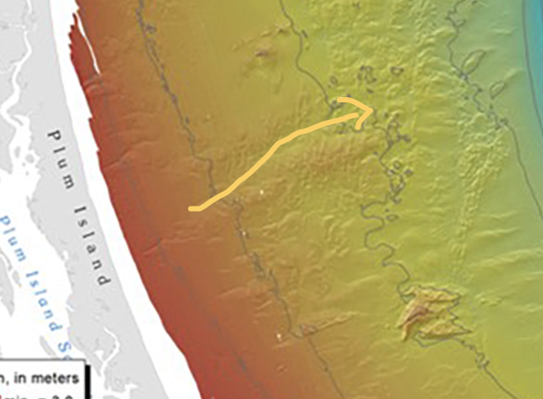
Coastal Submarine topography
previous knowledge: based on the topography, we should get prior knowledge about the answer of where is possibly safe or not.
For example, I think it is more reasonable occur a rip current at the yellow arrow(not proved)
Based on this, there could be a

Slide 3
Got the pattern sequence to the rip current

Slide 4
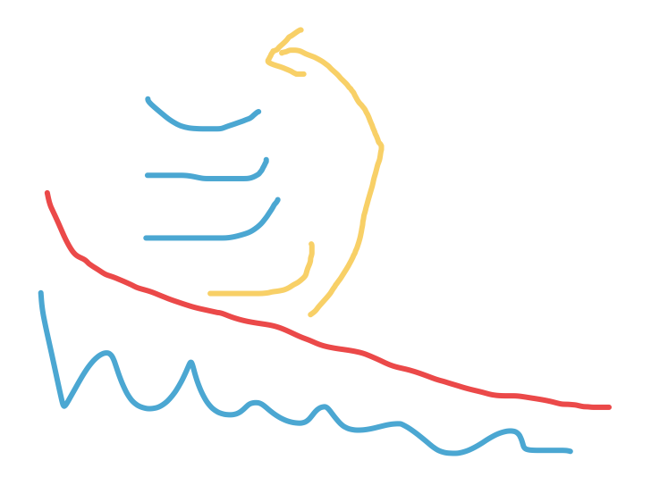
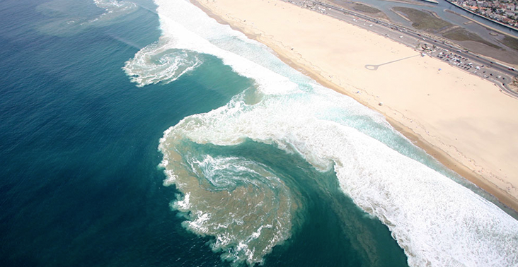
Policy network: Take actions based on the statistical history
Training to extract meaningful wave patterns, image grayscale, and color, temperature, wind, etc.
Build sequences of these patterns for each grid till the event of rip current happened.

Slide 5
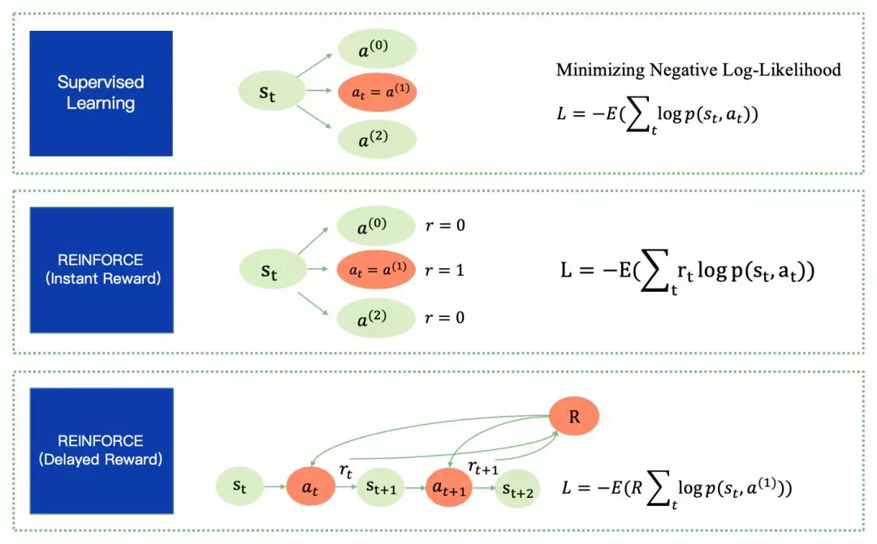
Delayed reward

Slide 6
YOLO for object detection

